Slide 1
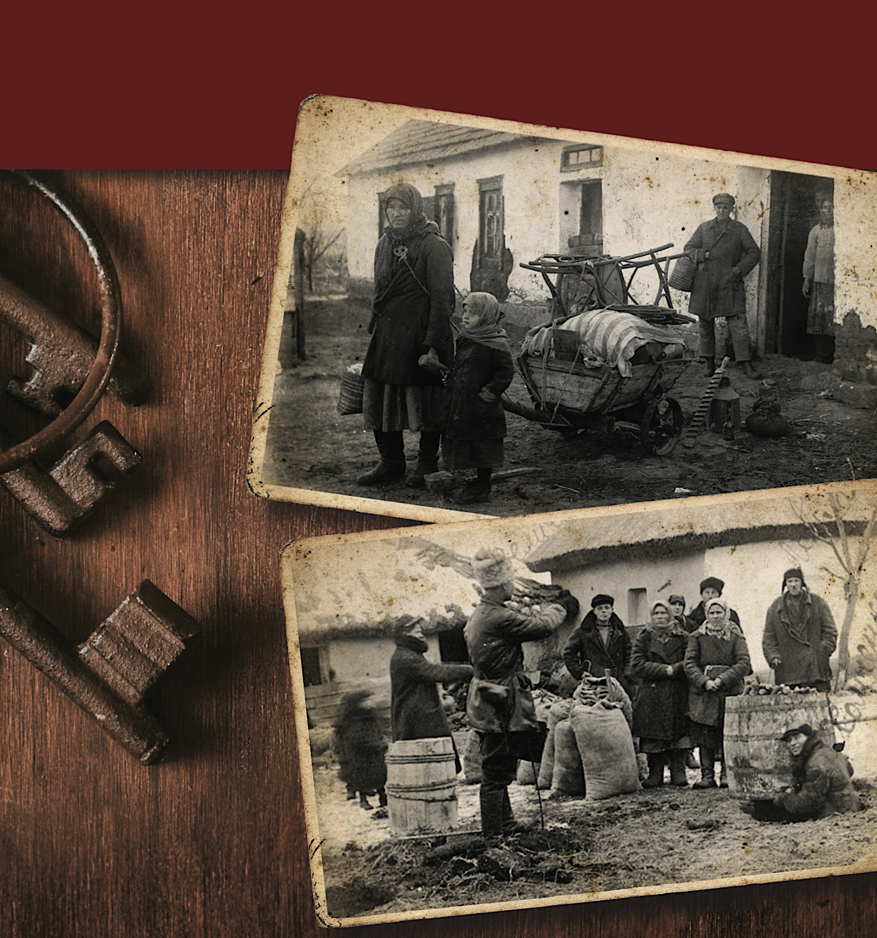
Valentina Kuryliw Director of Education
Notes:
Cover slide

Slide 2
UN Declaration of Human Rights:
Article 1: All human beings are created equal in dignity and rights.
They are endowed with reason and conscience and should act towards one another in a spirit of brotherhood.
It is the foundation of freedom, justice and peace in the world.
HREC Education
2
Notes:
The UN Declaration of Human Rights was passed in 1948. This is Article 1. Ask the students: What rights do you have according to Article 1 of the UN Declaration of Human Rights?

Slide 3
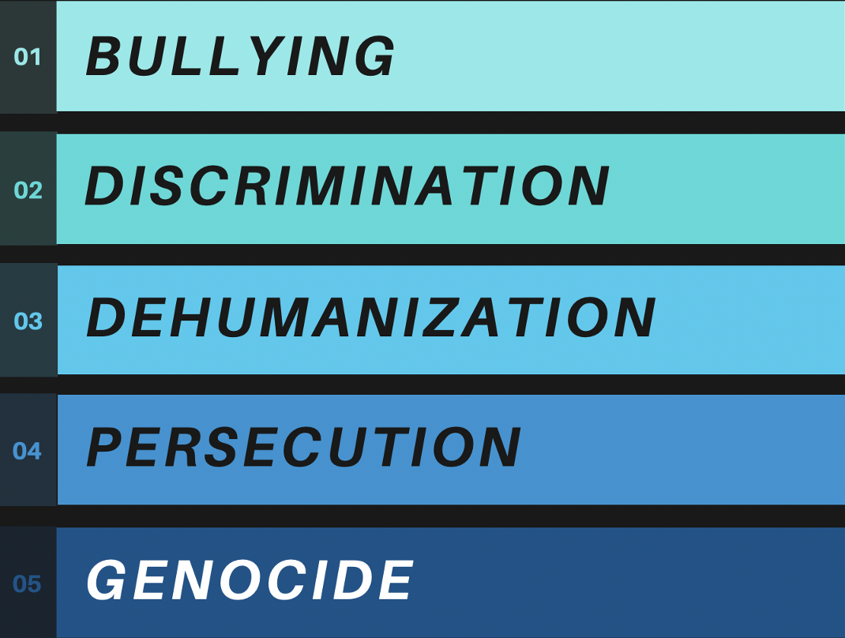
STAGES OF HUMAN
RIGHTS ABUSE
HREC Education
3
Notes:
These stages of human rights abuse follow consecutively from one to the other if they are not stopped and accelerate to genocide. Ask the students: At what point can human rights abuses still be stopped by society or the government to prevent genocide? Let the students think about that. Then let them know that when the government itself becomes involved in any of these stages to dehumanize or persecute then it is no longer possible to stop genocide. If people don’t protest there is a definite escalation. Genocide is the extreme form of bullying.

Slide 4
“A genocide begins with the
killing of one man –
not for what he has done,
but because of who he is.”
Kofi Annan,
Secretary-General of the UN (1997-2006)
HREC Education
4
Notes:
Ask the students: What does this tell us, in your own words? See page 17 of Lesson.

Slide 5
UN CONVENTION ON THE PREVENTION AND PUNISHMENT OF THE CRIME OF GENOCIDE, 1948
Article 2:
In the present Convention, genocide means any of the following acts committed with intent to destroy, in whole or in part, a national, ethnical, racial or religious group, as such:
(a) Killing members of the group;
(b) Causing serious bodily or mental harm to members of the group;
(c) Deliberately inflicting on the group conditions of life calculated to bring about its physical destruction in whole or in part;
(d) Imposing measures intended to prevent births within the group;
(e) Forcibly transferring children of the group to another group.
HREC Education
5
Notes:
Have students read this out in class and discuss it. Is there anything they don’t understand? Does this make sense? See page 17 of Lesson.

Slide 6
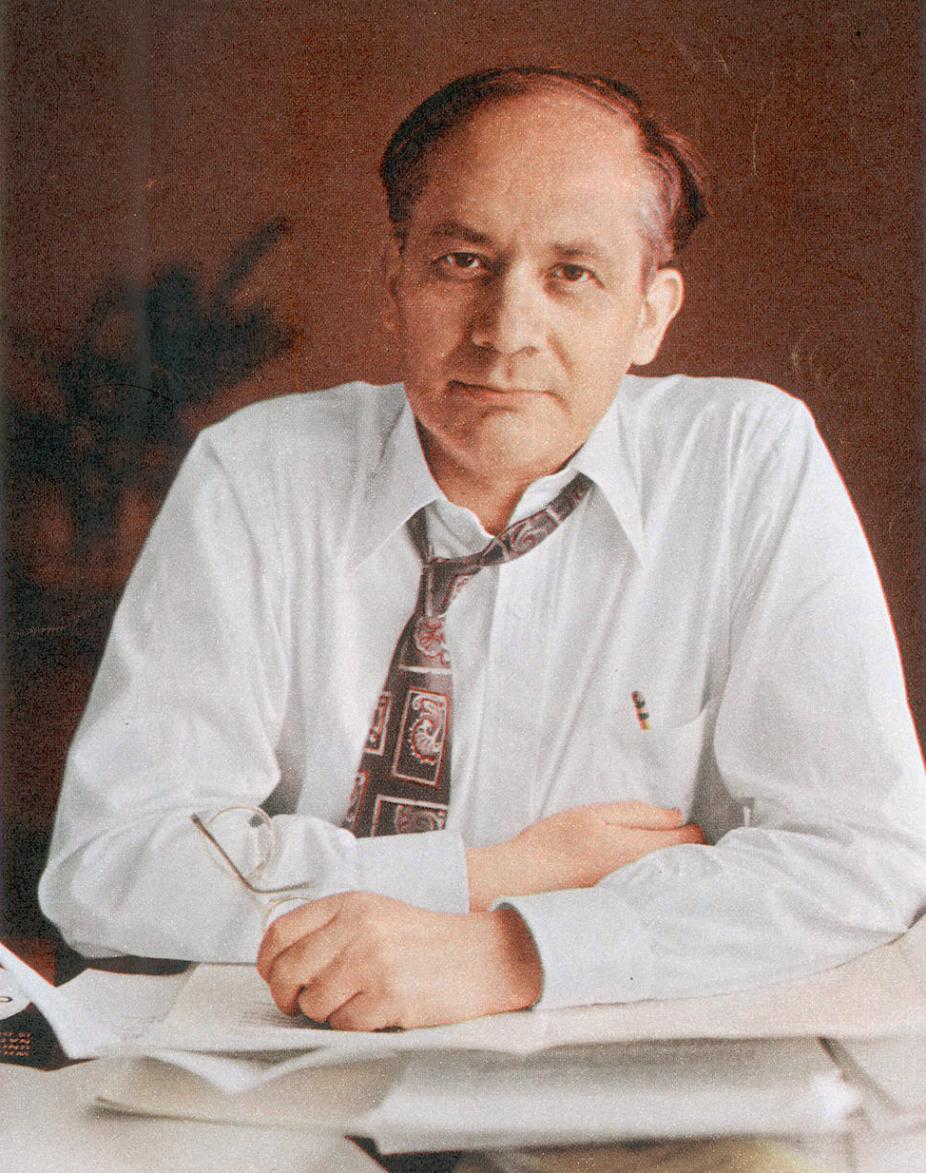
“What I want to speak about is perhaps the classic example of Soviet genocide, its longest and broadest experiment in Russification – the destruction of the Ukrainian nation.”
Raphael Lemkin, ”Soviet Genocide in …Ukraine,” 1953
HREC Education
6
Notes:
See notes for Slide 6 on page 17 of Lesson.

Slide 7
Holodomor:
means
“Death inflicted by starvation”
or
“Murder by starvation”
holod – famine/starvation
moryty – to cause destruction, to murder
HREC Education
7
Notes:
Introduce students to the term “Holodomor” and its definition. See page 17 of Lesson.

Slide 8
8
HREC Education
Notes:
Ask students: Which colour shows the highest number of deaths by starvation? Note that the area known for wheat production is in the peach colour, not the red colour. The red colour with the largest number of deaths is where the greatest opposition and revolts against collectivization and Communism occurred.

Slide 9
HISTORICAL VIDEO The first 10-minute segment of The Soviet Story https://www.youtube.com/watch?v=zZTA8xc4_8w or Holodomor, Voices of Survivors https://vimeo.com/129845758 or FAST’s Voices into Action (Unit 2, Chapter 5) https://www.voicesintoaction.ca/Lessons/Unit2/Chapter5?_role=educator
Consider the following::
Who are the victims
and the perpetrators
of the Holodomor?
Why were the
Soviets concerned
about Ukraine?
HREC Education
9
Notes:
Choose one of these three videos (or any other of your selection) to give students some background on what was happening in Ukraine in the 1920s and 1930s. Ask them to consider the questions in the blue box as they watch the video. See Notes on page 18 of the Lesson.

Slide 10
The Historian’s Craft Lesson on the Holodomor LEARNING ACTIVITY
Kids being put into groups image?
HREC Education
10
Notes:
Tell students they will be going into their various groups based on the colour card they received upon entering the classroom. There should be a resource package for each student on each group table.

Slide 11
This learning activity takes 15 min.
There are 6 groups. Each participant belongs to a group based on the colour card you received. Each of you is an active participant! Your role is assigned on the card as a:
15 min.
11
HREC Education
Notes:
To explain to students what they will be doing individually and as groups, see Notes on page 19.

Slide 12
12
HREC Education
Notes:
Instructions for Analysis of Resources: Students have 10 minutes to analyze, 5 minutes to write and 3 minutes tops to present. See Notes on page 20 for explanations.

Slide 13
GROUP PRESENTATIONS
HREC Education
13
Notes:
The presenter for each group presents their findings to the class. Please start with the red group and follow the colours in slides. See Notes on page 20.

Slide 14
Resolution “On safekeeping property of state enterprises, collective farms and cooperatives, and strengthening public (socialist) property” August 7, 1932 II Make all property belonging to collective farms and cooperatives (harvests in the fields, public reserves, livestock, cooperative stock and stores, etc.) equivalent to state property and fully strengthen the protection of this property against theft. Use judicial repressions of the highest degree as measures of social protection against theft of kolhosp and collective property: execution by shooting and confiscation of all property, variable under mitigating circumstances to ten years imprisonment with confiscation of all property. 3) Amnesty cannot be granted to criminals sentenced in cases of collective farm and cooperative property theft. III 1) Conduct decisive battle with all anti-public, kulak-capitalist elements that use violence and threats, or promote the use of violence and threats, against collective farmers, forcing them to leave or purposefully destroy collective farms. 2) Use measures of judicial repressions for protecting collective farms and collective farmers from violence and threats on the part of kulak and other anti-public elements: imprisonment for five to ten years in a concentration camp. 3) Amnesty cannot be granted to criminals sentenced in these cases. Head, USSR Central Executive Committee, M. Kalinin Head, Council of Peoples’ Commissars, V. Molotov (Skryabin) Secretary, USSR Central Executive Committee, А. Yenukidze Source: Communist newspaper, August 9, 1932; “Collectivization of agriculture: the most important resolutions of the Communist Party and Soviet government, 1927-1935,” Moscow, 1957, pp. 423-424.
HREC Education
14
Notes:
Have students themselves identify to their peers what type of resource they had in each group. (Official primary source documents group).

Slide 15
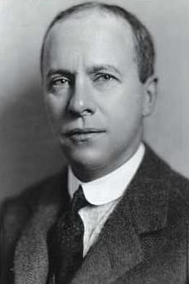
A Tale of Truth and Two Journalists
Report Magazine | March 27, 2000 | Ian Hunter
[…] The Dean of the Moscow press corps was Walter Duranty of the New York Times. Joseph Alsop would later say of him: “Lying was Duranty’s stock in trade.”
For two decades Duranty was the most influential foreign correspondent in Russia. His dispatches were regarded as authoritative; indeed Duranty helped to shape U.S. foreign policy. His biographer, Susan Taylor (Stalin’s Apologist, Oxford University Press, 1990) has demonstrated that Duranty’s reporting was a critical factor in President Roosevelt’s decision in 1933 to grant official recognition to the Soviet Union.
Duranty, an unattractive, oversexed little man, with a wooden leg, falsified facts, spread lies and half truths, invented occurrences that never hap­pened, and turned a blind eye to the man-made famine that starved to death more than 14 mil­lion people (according to an International Com­mission of Jurists which examined this tragedy in 1988-90). […]
Enter Malcolm Muggeridge. In the spring of 1933 Muggeridge did an audacious thing; without per­mission he set off on a train journey through what had formerly been the breadbasket of the Soviet Union, the Ukraine and North Caucasus. What Muggeridge witnessed, he never forgot. In a series of articles smuggled out in the diplomatic pouch, he described a man-made famine that had be­come a holocaust: peasants, millions of them, dy­ing like famished cattle, sometimes within sight of full granaries, guarded by the army and police. […]
Walter Duranty
Malcolm
Muggeridge
HREC Education
15
Notes:
(Archival newspaper media group).

Slide 16
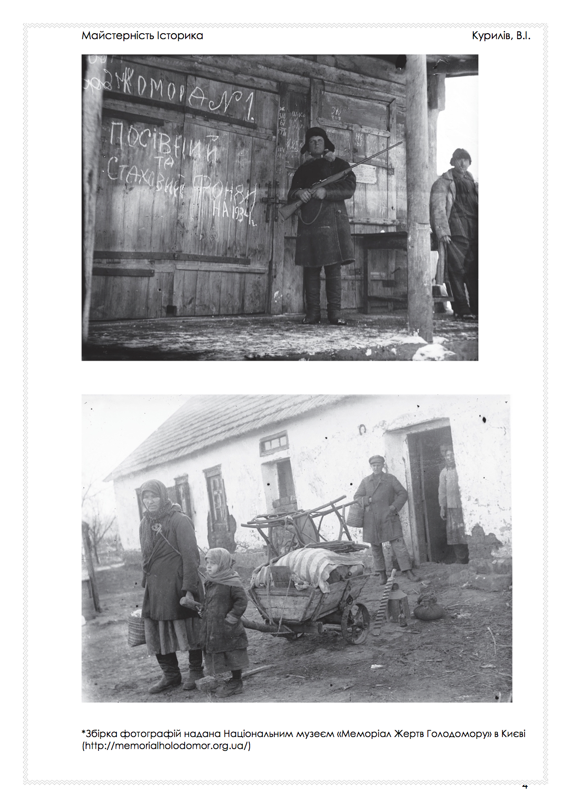
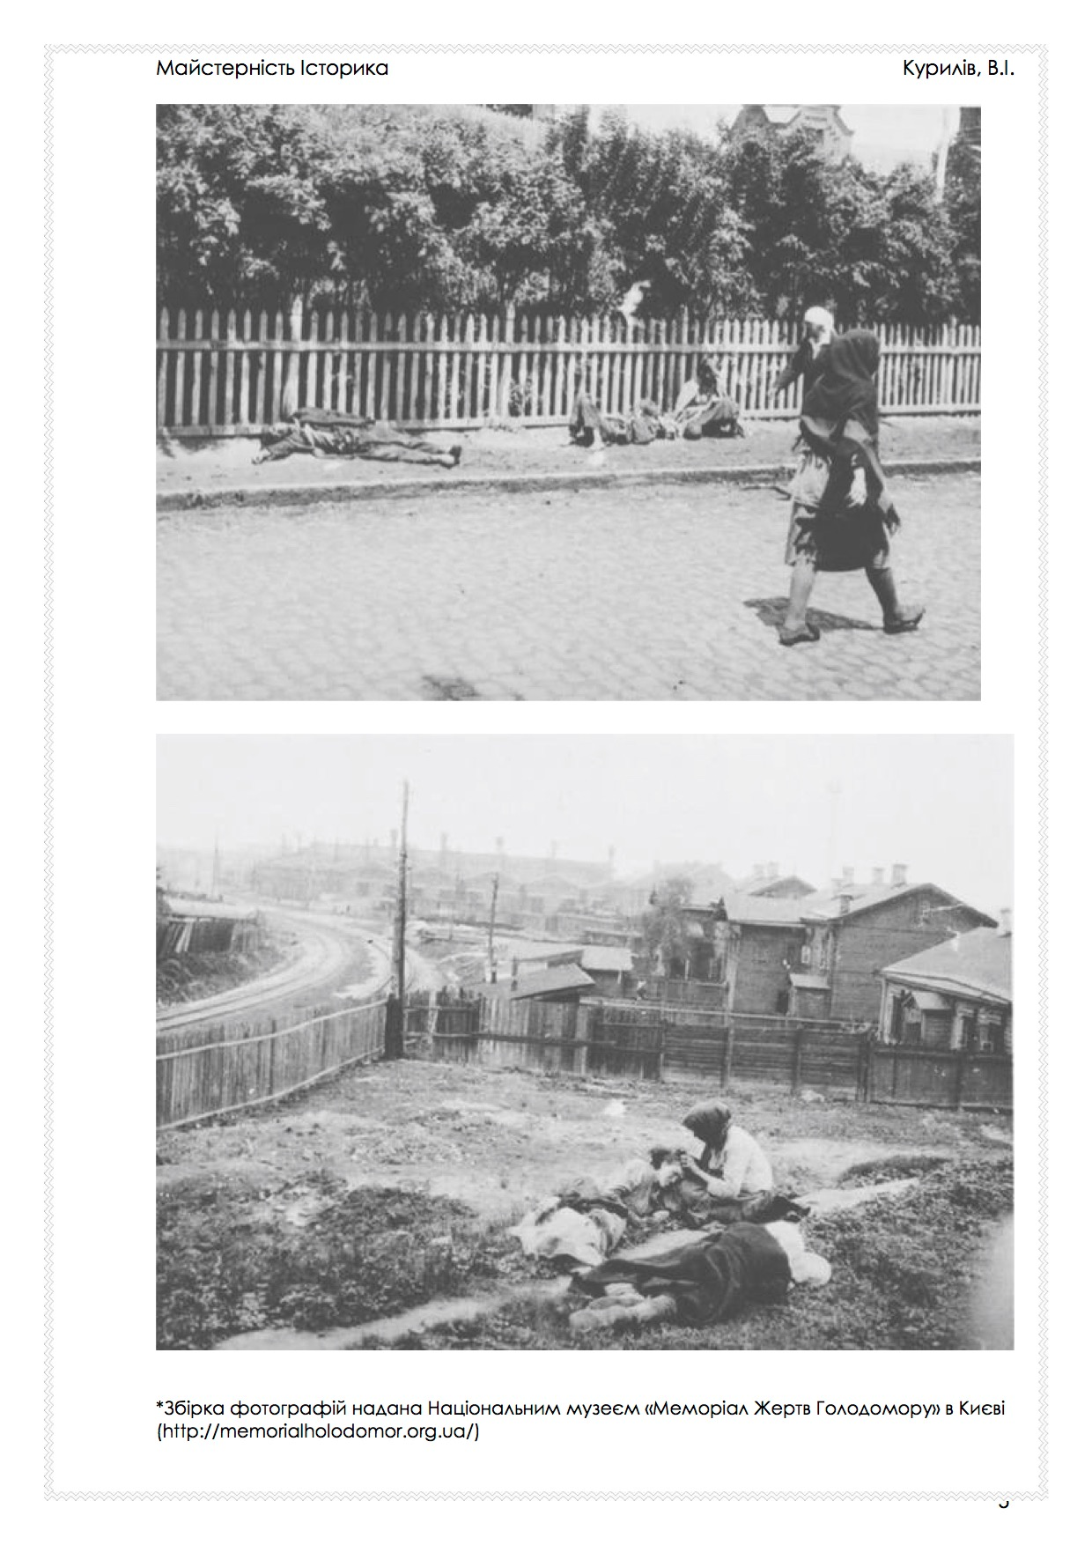
16
HREC Education
Notes:
(Archival photos group).

Slide 17
“The Terror-Famine of 1932-33 was a dual-purpose by-product of collectivization, designed to suppress Ukrainian nationalism and the most important concentration of prosperous peasants at one throw.”
Norman Davies, Europe: A History, Oxford: Oxford University Press, 1996
“... On one side, millions of starving peasants, their bodies often swollen from lack of food; on the other, soldiers, members of the GPU carrying out the instructions of the dictatorship of the proletariat. They had gone over the country like a swarm of locusts and taken away everything edible; they had shot or exiled thousands of peasants, sometimes whole villages; they had reduced some of the most fertile land in the world to a melancholy desert.”
Malcolm Muggeridge, British foreign correspondent, "War on the Peasants," Fortnightly Review, 1 May 1933
“This is why, on the basis of the changed situation, we consider that local, Ukrainian nationalism is the principal danger in Ukraine at the present time.”
S.V. Kosior, “The Results and Immediate Tasks of the National Policy in the Ukraine.” Article in Soviet Ukraine Today. Moscow: Cooperative Publishing Society of Foreign Workers in the USSR, 1934, p. 95
HREC Education
17
Notes:
(Primary Source Quotations group).

Slide 18
Letter from Yu. Shvets, a collective farmer from the Lenin’s Testament collective farm, village of Horozhene, Bashtan district, to head of the All-Ukrainian CEC, Hryhorii Petrovsky, about the unjust grain-procurement plan for the collective farm and the starvation of collective farmers In Holod-henotsyd 1932-1933 rokiv v Ukraini (2005). Excerpts, pp. 11-16. Translated by Maksym Motorenko and Bohdan Klid 13 September 1932 Comrade Petrovsky In 1931 our cooperative had 2,400 hectares of land and was completely sown, but as we have a good deal of land close to the river, and its useless, the district [authorities] directed our cooperative to use this land for particular agricultural needs – growing vegetables, raising cattle and pigs… Our cooperative has 1,502 people to be fed, and here, in 1931, most of our cooperative members – poor peasants – were starving, beginning in December. In this year of 1932, the cooperative sowed 600 hectares of grain crops… When the District Executive Committee apportioned the grain-procurement plan, our cooperative was obliged to fulfill a grain-procurement plan of 2,400 poods of grain. But, Comrade Petrovsky, if we stretch it considerably, perhaps there will be enough [grain] to fulfill the established plan, but there will be absolutely nothing left for food… So please explain to me: has full agreement been reached with our district authorities to leave our village and cooperative hungry for the whole year, or have former landowners perhaps… Yu. R. Shvets….
HREC Education
18
Notes:
(Archival Letters group)

Slide 19
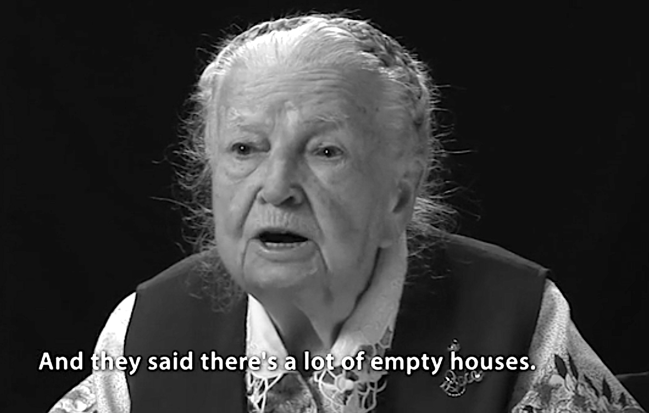
SURVIVOR ACCOUNT
Kateryna Shcherban (3.45min)
The Famine was in 1933, and on 24 February 1934, we were resettled to Kharkiv oblast. There was a resettlement of people. And a second group of activists came, without the teacher, and tried to convince us to leave our village in Kyiv oblast and go to Kharkiv oblast, because there was a good land, lots of grain, and that we would always have a lot of food. These meetings would take place in someone's house, and I was already a bit older, so I was interested in what they would be saying after the Famine. So, they were telling us all this, agitating, and we were all silent, not asking anything, just listening, because people were scared ‐ that if you said anything, you would be considered a spy or whatever. But we kids were at the back, I had a strong voice, and I asked. Because people were asking where we would live once we got there. And they said there's a lot of empty houses. And we asked them, "why are there so many empty houses? Where are the people? Did they all die? Did you bury them all?" (…)
HREC Education
19
Notes:
(Survivor Accounts group)

Slide 20
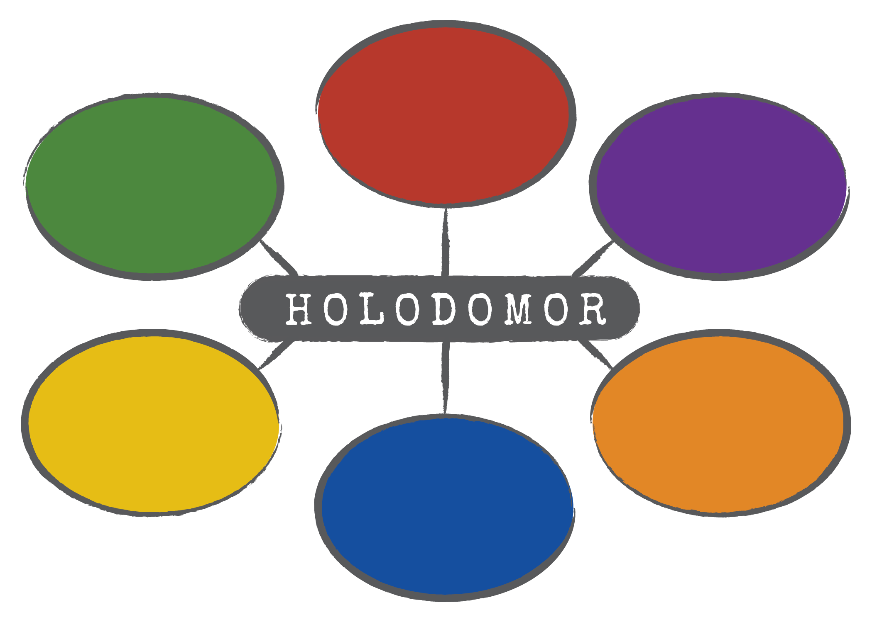
HREC Education
20
Notes:
Mind Map Exercise: What is the MOST important thing you learned in your group about the Holodomor? Create a mind map of student conclusions. See Notes on page 21.

Slide 21
HREC Education
21
Notes:
Mind Map: some examples of the kinds of answers that might be stated. See Notes on page 21.

Slide 22
What can you do to become an active citizen
in your school and in your community?
HREC Education
22
Notes:
Conclusion: Ask this question of students, let them discuss and write down at least 3 or 4 suggestions on the board in the classroom. See Notes on page 22.

Slide 23
“A genocide begins with the
killing of one man –
not for what he has done,
but because of who he is.”
Kofi Annan,
Secretary-General of the UN (1997-2006)
HREC Education
23
Notes:
Conclusion: return to Kofi Annan quote. See Notes on page 22.

Slide 24
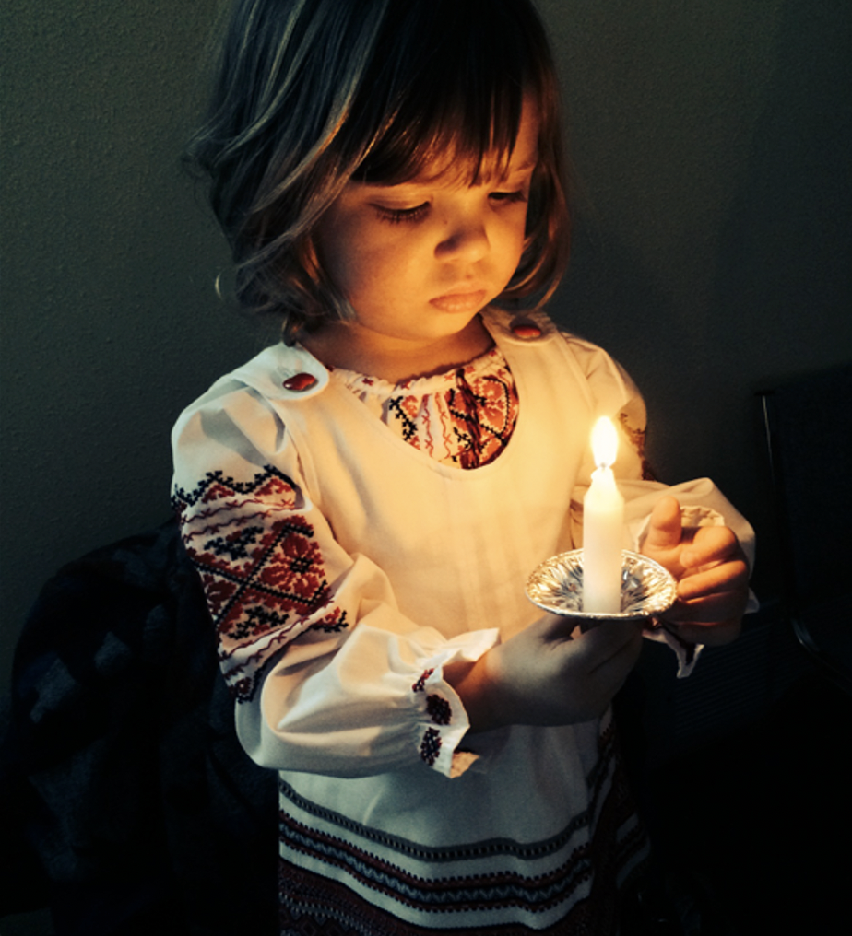
HOLODOMOR MEMORIAL DAY
Запали свічку.
Light a candle.
On the 4th Friday of November each year, schools across Canada commemorate the Holodomor to remember those who were starved to death and those who survived.
Worldwide commemoration is on the
4th Saturday in November annually.
www.education.holodomor.ca
HREC Education
24
Notes:
Can the Holodomor be related in any way to Russia’s invasion in 2014 and full-scale war on in 2022?

Slide 25
Valentina Kuryliw, Director of Education
Holodomor Research and Education Consortium
(HREC Education)
1932–1933 Archive Photo Documents, National Museum of the Holodomor-Genocide, Kyiv, Ukraine. Electronic resource: https://holodomormuseum.org.ua/en/
FAST – Voices Into Action, “Exposing the Ukrainian Holodomor – How starvation was used as a political weapon” video (Unit 2, Chapter 5), 2017. Electronic resource: www.voicesintoaction.ca/Learn/Unit2/Chapter5/
Hunter, Ian. “A Tale of Truth and Two Journalists,” Report Magazine, March 27, 2000.
Klid, Bohdan, and Alexander J. Motyl, eds. The Holodomor Reader: A Sourcebook on the Famine of 1932–1933 in Ukraine. Edmonton: CIUS Press, 2012.
Kuryliw, Valentina. Holodomor in Ukraine, the Genocidal Famine 1932–1933: Learning Materials for Teachers and Students. Toronto: CIUS Press, 2018.
Ochrymovych, Ariadna, prod. and dir. Holodomor, Voices of Survivors. Toronto: Ukrainian Canadian Research and Documentation Centre, 2015. Electronic resource: https://www.youtube.com/watch?time_continue=2&v=F5YjztNdRwk&feature=emb_logo
Pyrih, Ruslan, ed. Holodomor of 1932–33 in Ukraine: Documents and Materials. Translated by Stephen Bandera. Kyiv: Kyiv-Mohyla Academy Publishing House, 2008.
Šnore, Edvīns, dir. The Soviet Story. 2008. Electronic resource: https://www.youtube.com/watch?v=zZTA8xc4_8w&feature=youtu.be
Ukrainian Research Institute, Harvard University. Famine Web Map. Electronic resource: http://gis.huri.harvard.edu/historical-atlas/the-great-famine/famine-web-map.html
Ukrainian Canadian Research and Documentation Centre, Ukrainian Canadian Congress, and Ukrainian World Congress. Share the Story. Electronic resource: www.sharethestory.ca
Bibliography:
PowerPoint by Sophia Isajiw
HREC Education
25
Notes:
Sources and resources recommended by HREC Education on the topic of the Holodomor. More available on our website under “Top Picks.”

